Slide 1

Bansilal Ramnath Agarwal Charitable Trust’s
VISHWAKARMA INSTITUTE OF INFORMATION TECHNOLOGY, PUNE-48
Department Of Information Technology
Class: BTech Subject : B.TECH Major Project A.Y. 2023-24
Speech Therapy And Assessment Application
For Autism Disorder
PRN | Roll Number | Name of Student
22010070 | 432002 | Niraj Amrutkar
22010910 | 432008 | Chirag Chawade
22010826 | 432009 | Harsh Chawla
22010917 | 432023 | Suniket Khairnar

Slide 2

INTRODUCTION
Motivation :
The primary motivation driving this project is the pressing need to address the speech and language development challenges faced by children diagnosed with Autism Spectrum Disorder (ASD).
ASD is a complex developmental condition that often manifests in communication difficulties, making early intervention essential.
Traditional methods of speech therapy are often constrained by geographic limitations and cost, hindering access to critical therapy services for many families.
To bridge this gap, the project embarked on the development of a mobile application tailored to the unique needs of children with ASD, offering a convenient, cost-effective, and accessible solution

Slide 3
ABSTRACT
Problem Statement: The integration of technology and specialized therapeutic methodologies into a cohesive, user-friendly mobile application, ensuring equitable access to high-quality autism intervention regardless of geographical or socioeconomic barriers
The mobile application employs modern technologies, with a focus on Android development and utilization of articulatory phonetics in the Marathi language.
The app features two core modules: an administrative section for customization and a user-friendly interface for children and their parents.

Slide 4

OBJECTIVE

Slide 5
Methodology

Slide 6
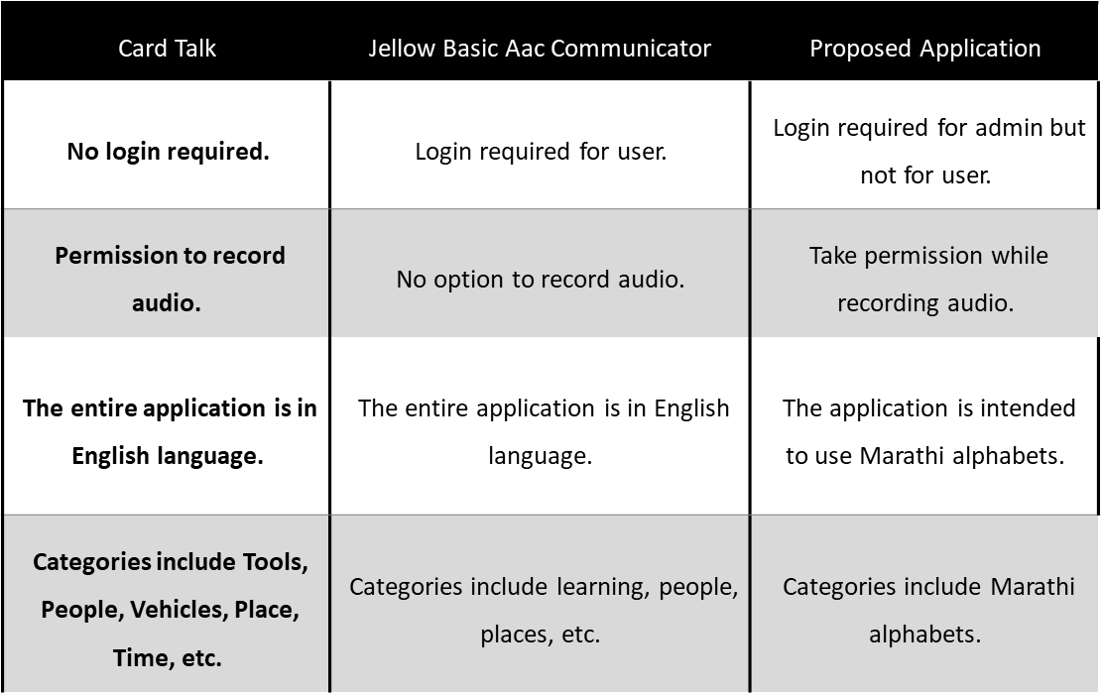
Review of Existing apps

Slide 7
Proposed system
The developed application functions as a dual-purpose system, comprising an administrative (doctor) module and a user module .
In terms of functionality, the application is designed to establish communication with a database for the secure storage of user data.
The administrative (doctor) module grants authorized users the ability to manage therapy content (cards), which includes tasks such as adding or deleting speech therapy materials (cards) and assessment questions specifically tailored to the Marathi language. It also allows doctors to view the profile and progress of patients.
Conversely, the user module offers children and their parents a user-friendly interface for participating in speech Speech Therapy Assessment Application therapy exercises, listening to audio pronunciations, and undergoing assessments to track their progress.

Slide 8
TOOLS/TECHNOLOGIES
BACKEND
DATABASE
FRONTEND
CSS, React Native.
Nodejs, Express.js
MySQL,
TOOLS
Git/Github, Android Studio, VS code, Cloudinary

Slide 9

PROPOSED OUTCOMES
Enhanced Communication Skills: Children with ASD will have access to a structured and engaging platform for speech therapy.
Convenience and Accessibility: Parents and caregivers will find the system convenient, as they can actively engage in therapy sessions with their children without the need for frequent visits to healthcare facilities.
Personalized Therapy: The system's ability to customize therapy materials and assessments ensures that each child's unique needs are addressed.
Language-Specific Support: For users in Marathi-speaking communities, the system provides language-specific support, making therapy content more relevant and effective.
Data-Driven Progress Tracking:. Assessment results and session data offer valuable insights for informed decision-making.

Slide 10
FUTURE WORK

Slide 11

CONCLUSION

Slide 12
Thank You

